Slide 1
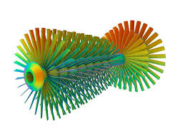
Finite Element Analysis of a Pentagon Structure
This project explores the structural behavior of a regular pentagon using Static Structural and Transient Structural simulation techniques.
Muhammad Abdul Moiz
ME-1902 Section: A

Slide 2

Abstract: Unveiling Structural Dynamics
Material Properties
Loading Conditions
Boundary Conditions
Young's Modulus: 2,000 MPa (from roll number ME-1902). Poisson's Ratio: 0.28.
Static Load: 2,020 N (from date of birth). Transient Load: 281.5 N (from USD to PKR exchange rate).
One face fixed, remote force applied at one-third of the face length.
The analysis compares deformation and stress results between static equilibrium and time-dependent transient responses.

Slide 3
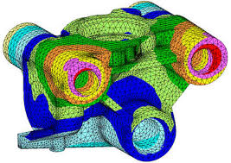

Introduction to FEA
Finite Element Analysis (FEA) is a numerical method predicting part behavior under physical conditions. This project analyzes a regular pentagon under two conditions:
Static Structural
Assumes slow load application, ignoring inertial and damping effects.
Transient Structural
Analyzes dynamic response over time, considering inertia and damping.

Slide 4






Problem Statement: Custom Constraints
The objective is to analyze a regular pentagon structure under custom-defined constraints based on personal data.
Material Properties
Loading Conditions
Boundary Conditions
Young's Modulus (E): 02 times 1,000 = 2,000 MPa. Poisson's Ratio: v = 0.28.
Static Load: 2,020 N (from date of birth). Transient Load: 281.5 N (from USD to PKR exchange rate).
One face fixed, remote force at 1/3rd distance. Time Step (Transient): 0.2 seconds.

Slide 5
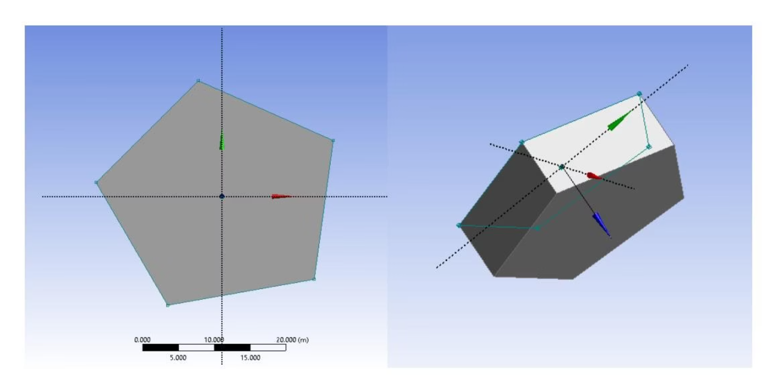
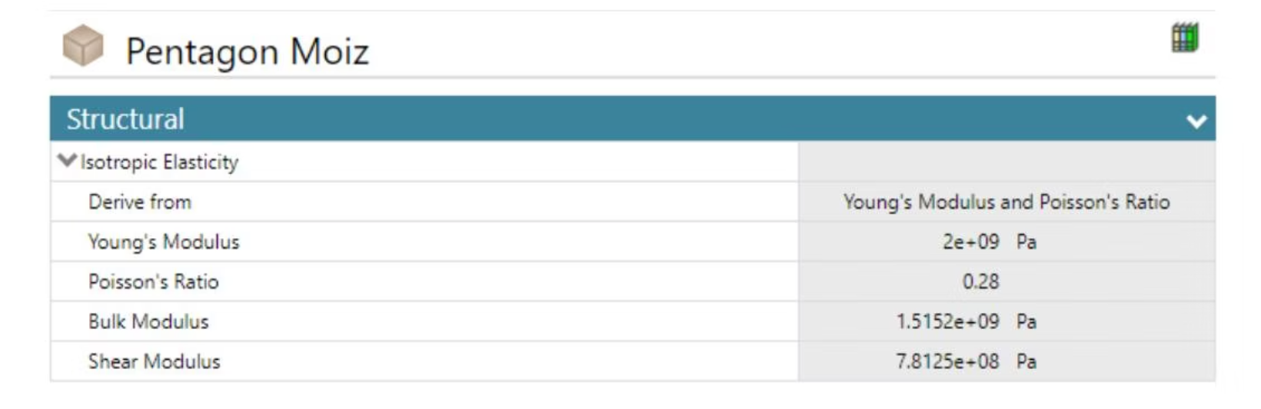
Geometry Modeling & Material Definition
Geometry Modeling
Material Properties
The regular pentagon was extruded to a specified thickness using DesignModeler/SpaceClaim within Ansys.
A custom material, "Pentagon Moiz," was defined with calculated stiffness values.
Figure 2: Engineering Data showing Young's Modulus of 2000 MPa.
Figure 1: 3D Geometry of the extruded pentagon model.

Slide 6
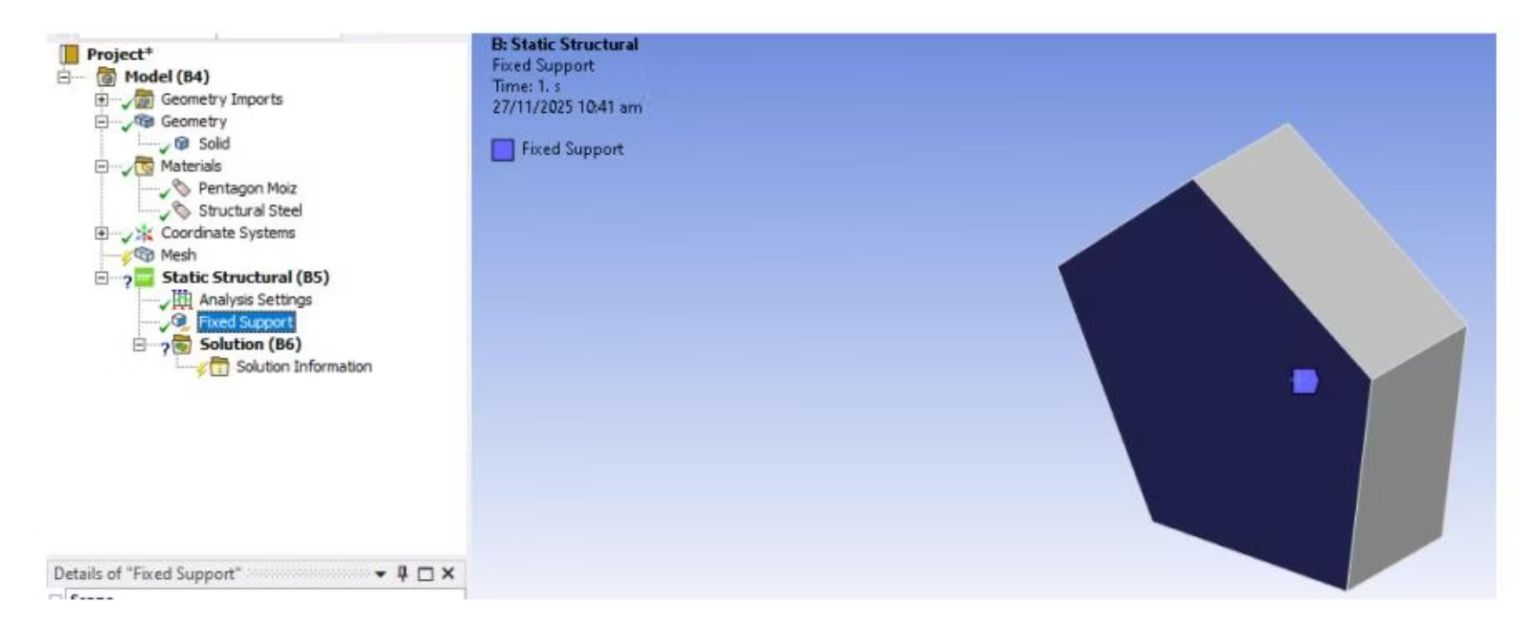
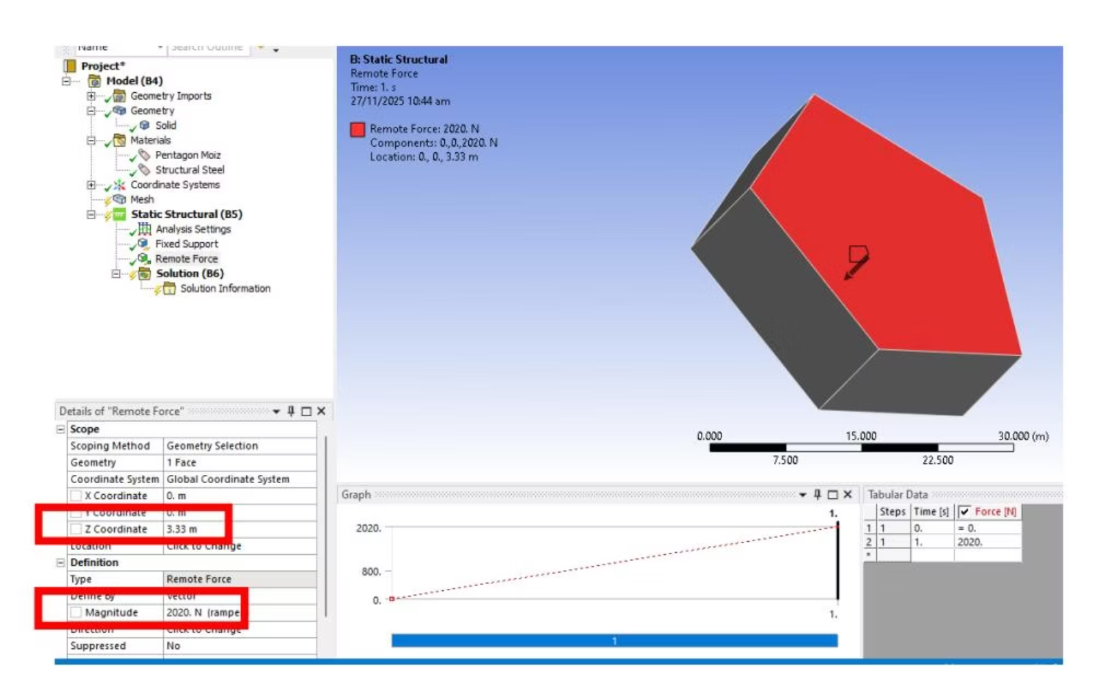
Boundary Conditions: Simulating Reality
To simulate physical bending and shear, specific constraints were applied.
Fixed Support
Remote Force
Applied to one side face of the pentagon.
Applied to the same face but offset to 1/3rd of the length, inducing rotation/bending.
Figure 3: Fixed Support applied to the face.
Figure 4: Remote Force applied at 1/3rd offset location.

Slide 7
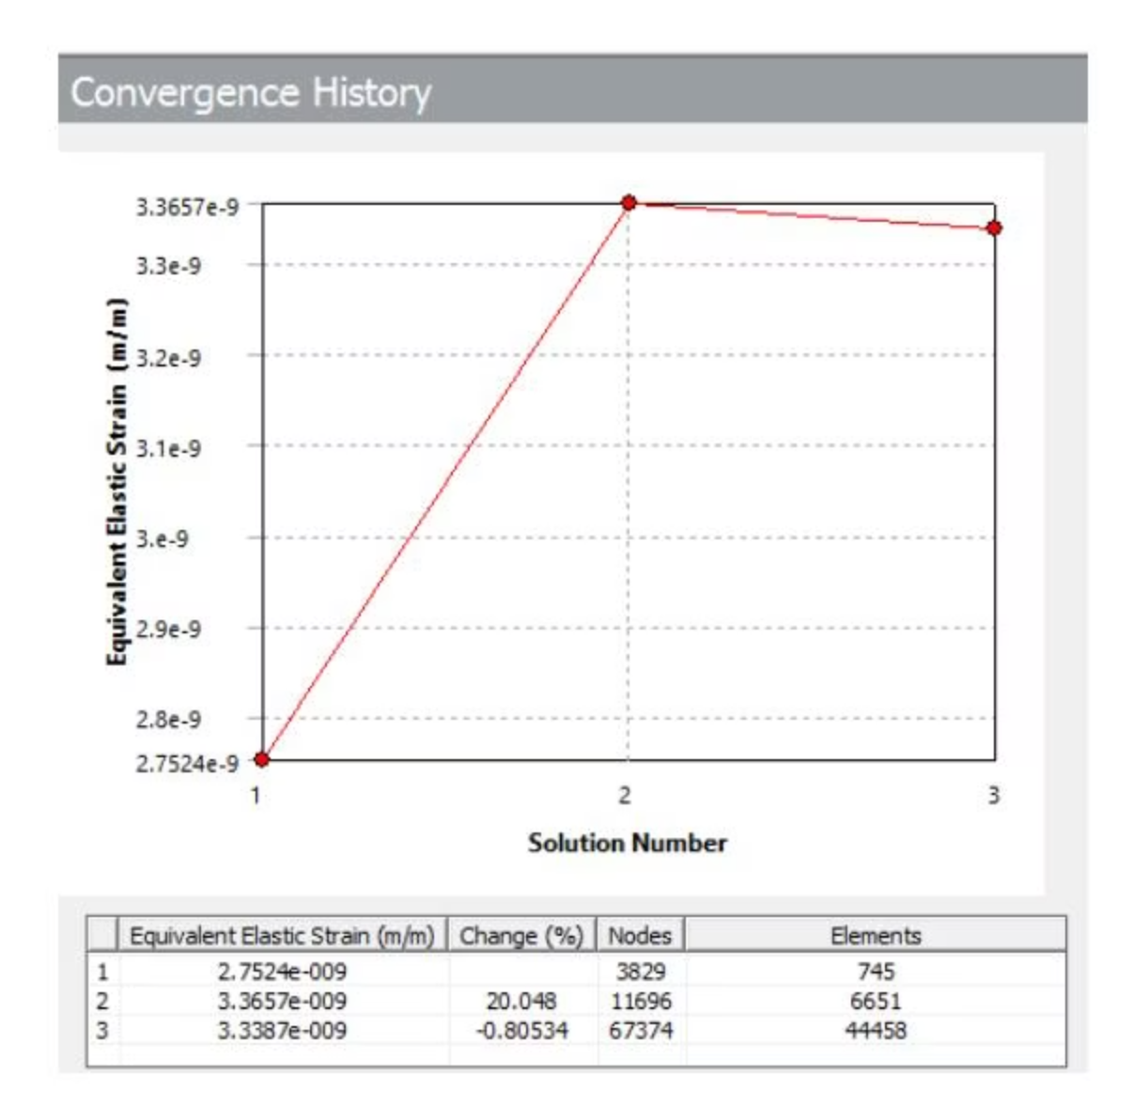
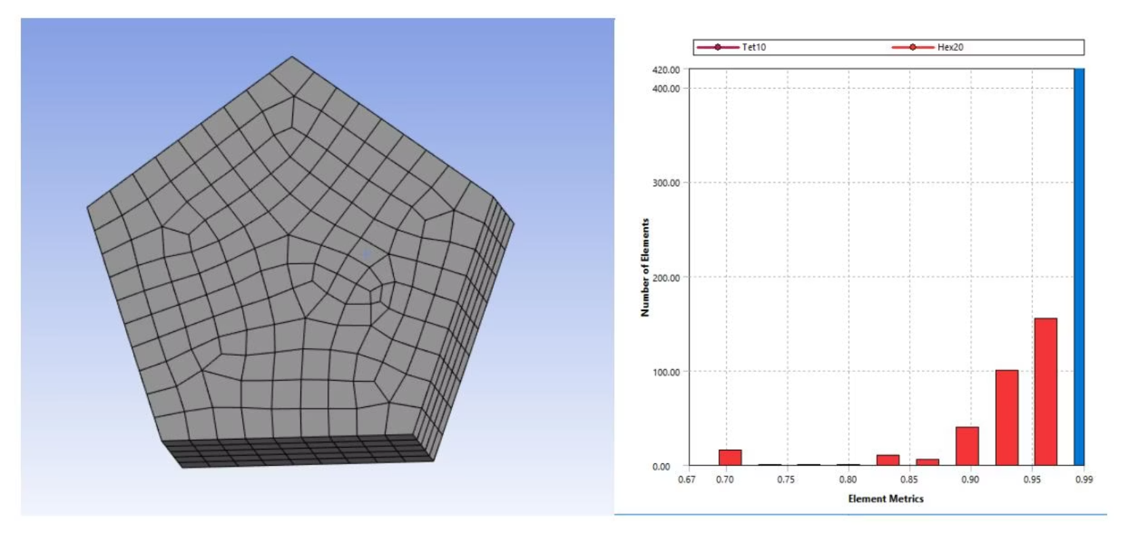
Meshing & Convergence for Accuracy
A mesh convergence study was conducted to ensure result accuracy, refining the mesh in three iterations to observe Equivalent Stress stability.
Figure 5: Meshed model of the pentagon with element Quality.
Figure 6: Mesh Convergence Graph (Nodes vs. Stress).

Slide 8
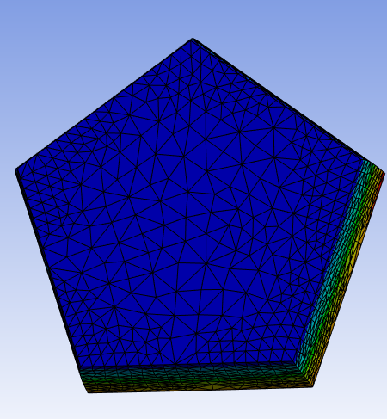
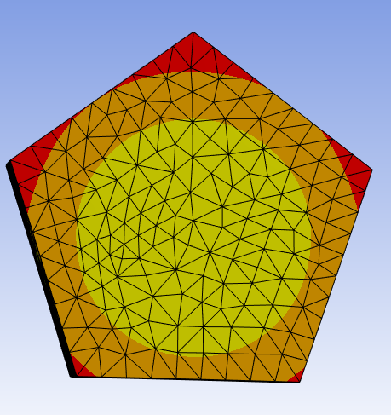
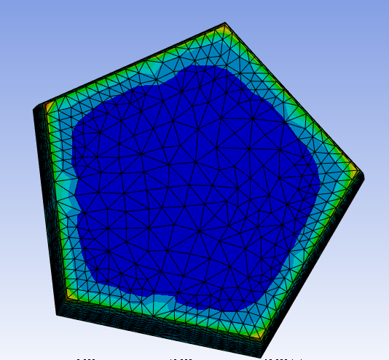
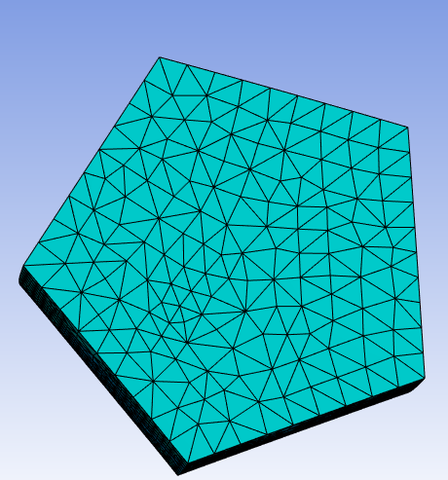
Static Structural Simulation: Equilibrium Analysis
In the static analysis, a load of 2,020 N was applied, and the solver calculated the final equilibrium state.
Total Deformation (Static)
Equivalent (von-Mises) Stress (Static)
Results: The static results show maximum deflection at the pentagon's tip opposite the fixed face.

Slide 9
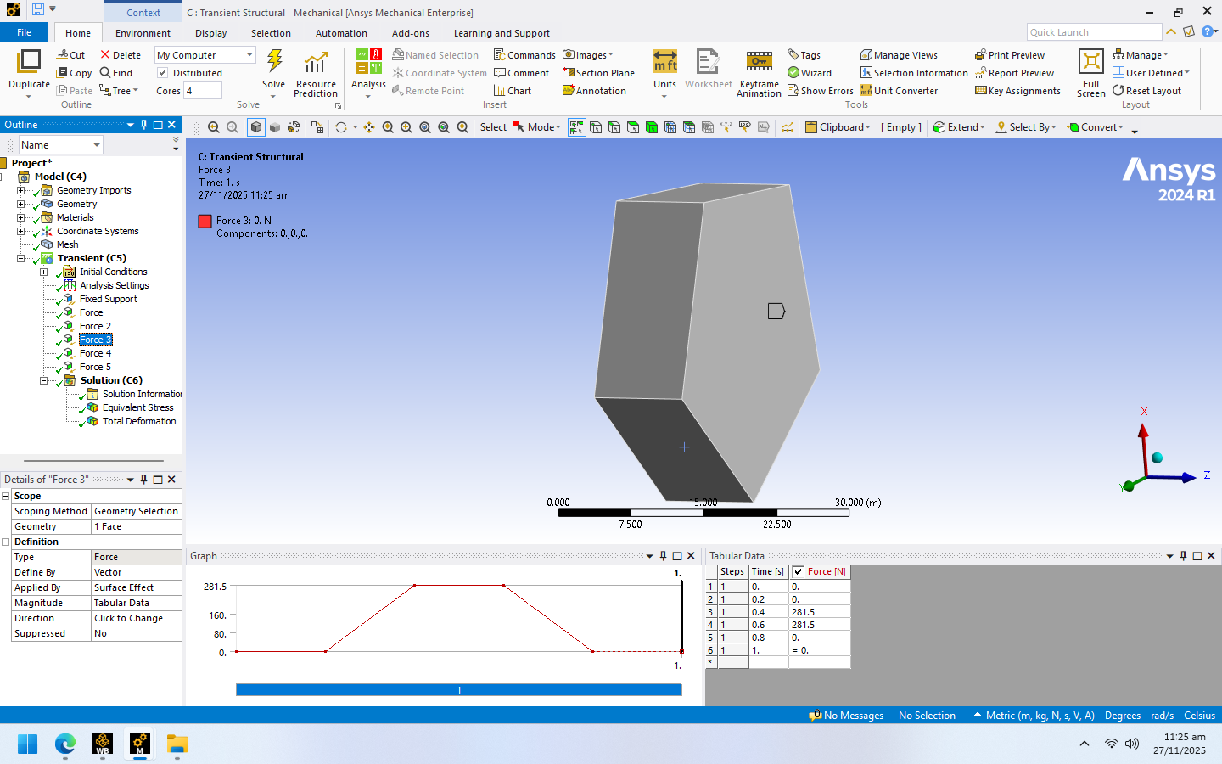


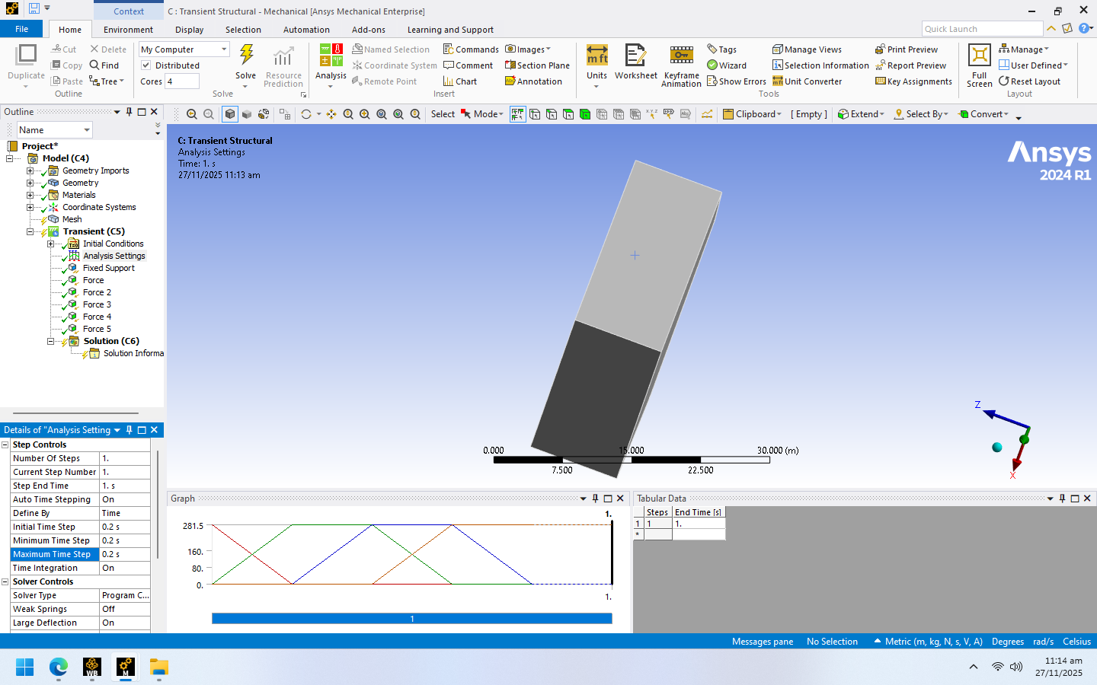

Transient Structural Simulation: Dynamic Response
The Transient Structural analysis determined the time-dependent response under a standard dynamic load over 1 second.
1
2
Load
Step End Time
281.5 N (USD Rate).
1.0 s.
3
Time Step
0.2 s.
Figure 9: Transient setup showing time steps of 0.2s and tabular data of force 3 with graph.

Slide 10
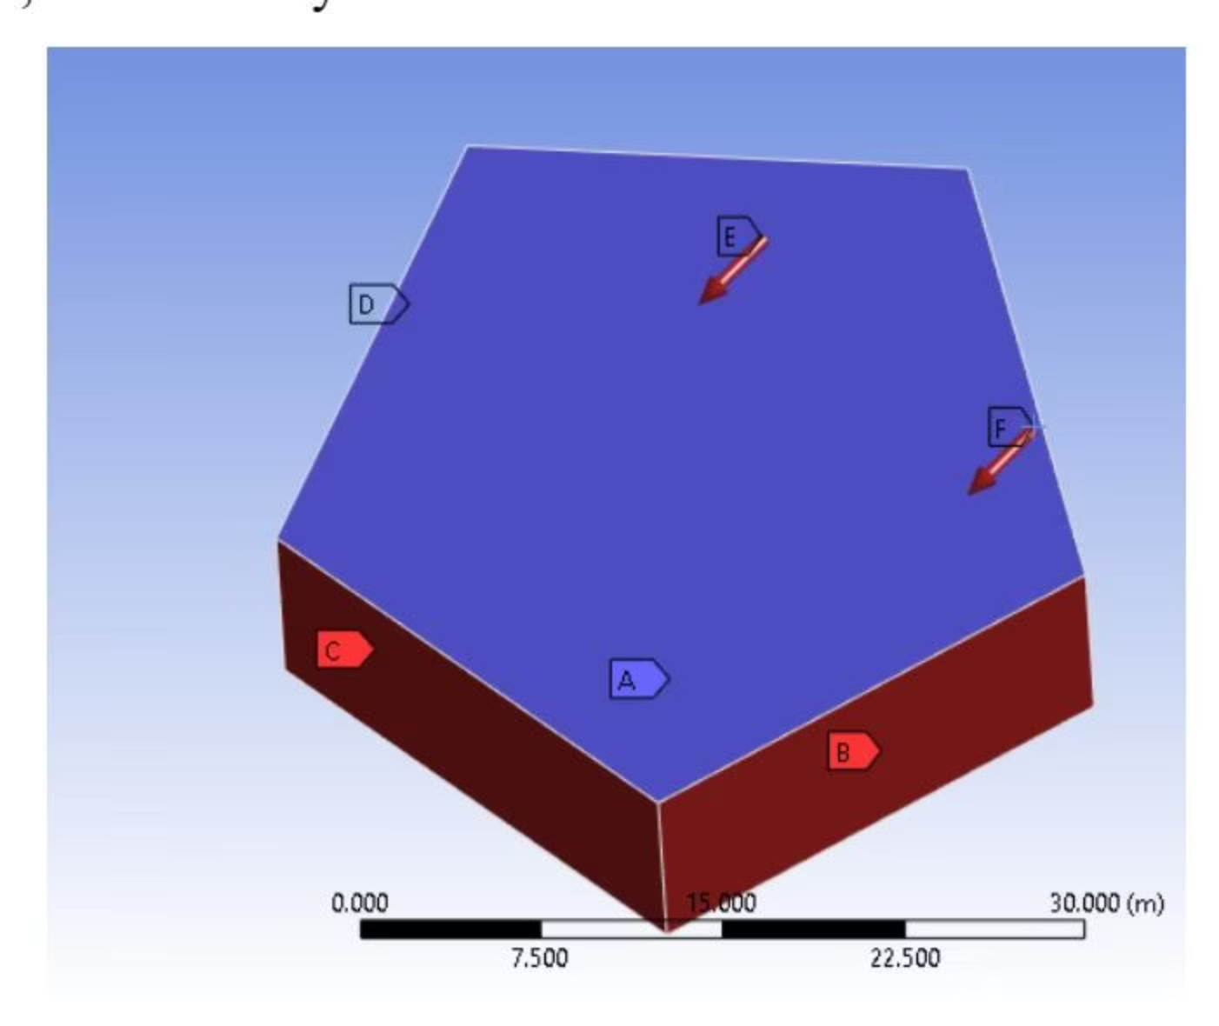
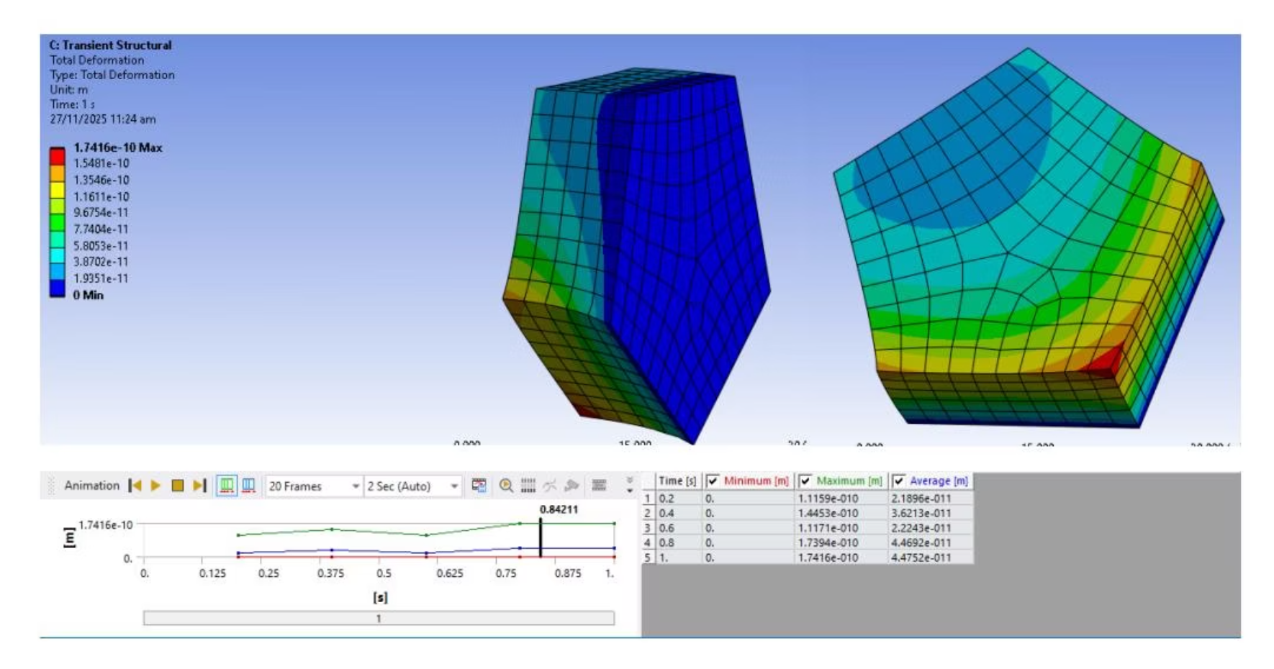
Transient Results & Conclusion
Boundary Conditions (Transient)
Results & Conclusion
Figure 10: Fixed Support (face A) and Remote Force (B,C,D,E,F) applied.
Figure 11: Total Deformation at t=0.842 = Total Deformation at 1.0s.

Slide 11
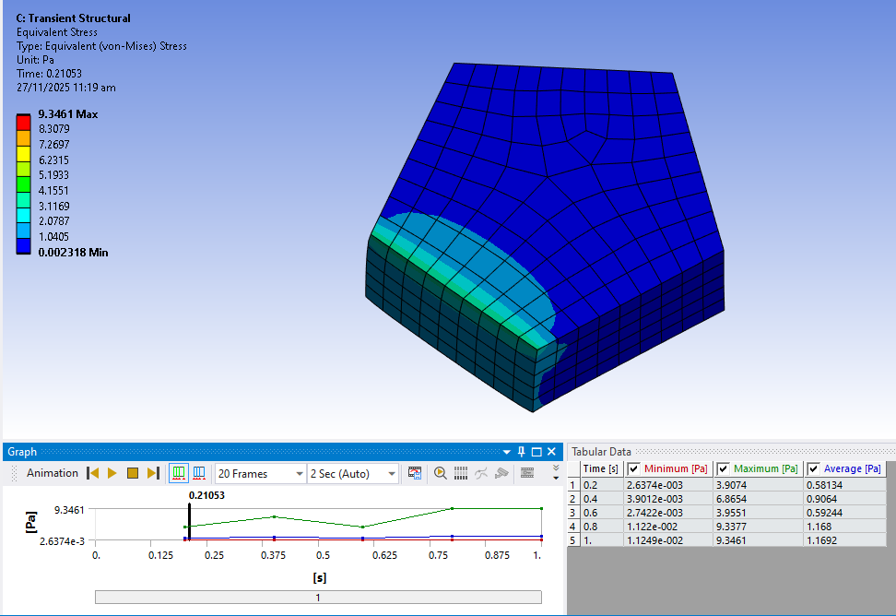
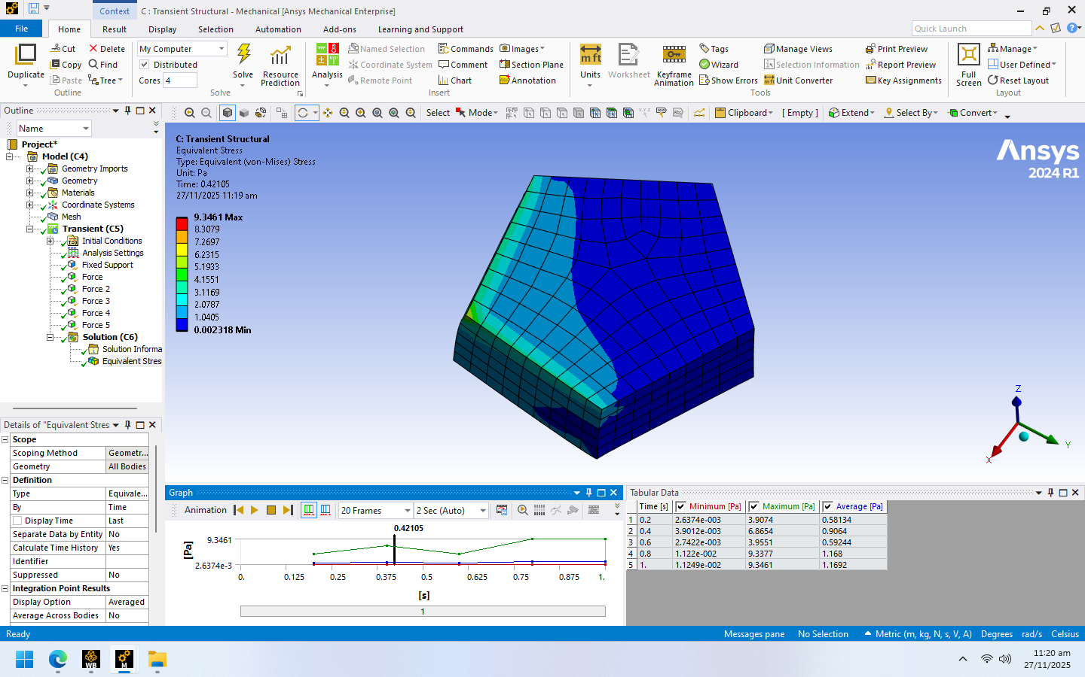
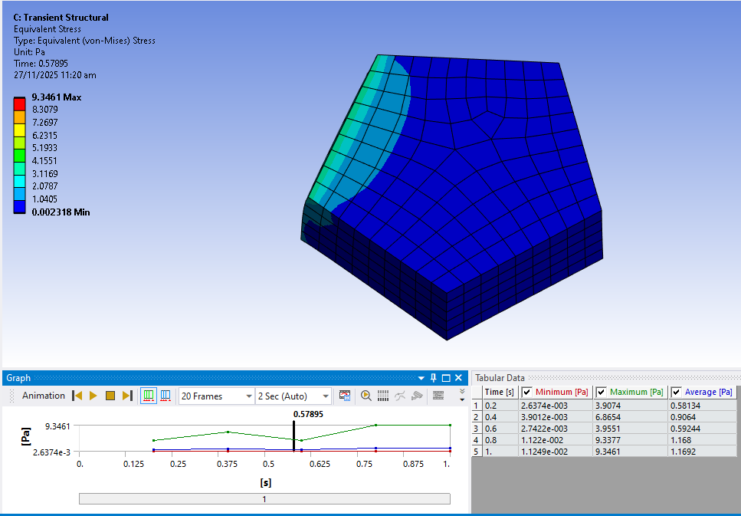
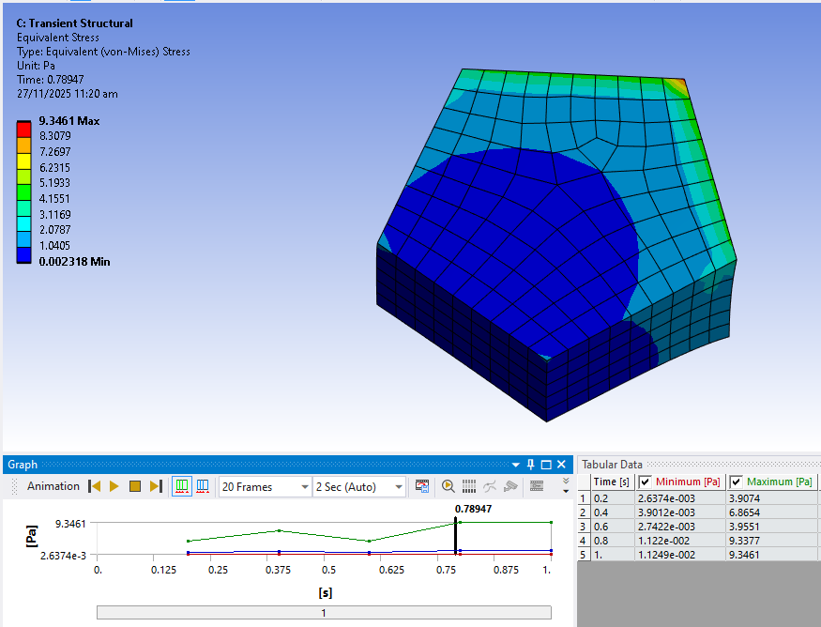
Transient Results & Conclusion
t=0.21053 sec
t=0.42105 sec
t=0.57895 sec
Figure 12: Equivalent Stress at different values of t (Transient).
The project successfully demonstrated FEA on a pentagon model using personal data for boundary conditions, comparing static and transient behaviors.
t=0.78947 sec

